Slide 1



Web and Internet
Class VI
lab 8

Slide 2
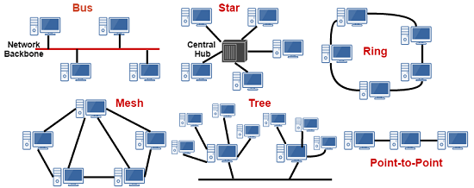
Network Topology
the arrangement with which computer systems or network devices are connected to each other

Slide 3

Point-to-Point
Point-to-point networks contains exactly two hosts

Slide 4
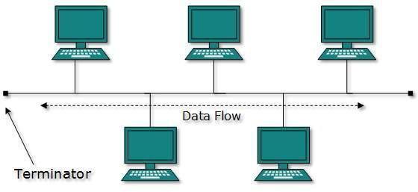
Bus Topology
all devices share single communication line or cable

Slide 5
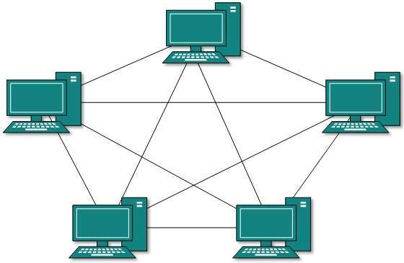
Mesh Topology
In this type of topology, a host is connected to one or multiple hosts

Slide 6
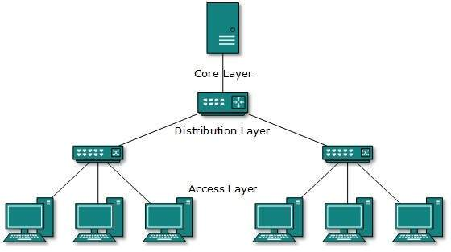
Tree Topology
Also known as Hierarchical Topology, this is the most common form of network topology in use presently

Slide 7


